Slide 1

Sentiment Analysis on Amazon Fashion Products
By: Mazen Alhaffar, Jun Ming Li, and Thasin Wahid

Slide 2
Table of content
Goal of the project
Dataset description
Experiment details
Visualization & Key Insights
Conclusion

Slide 3

Goal of the Project
Utilize sentiment analysis to classify customer reviews of Amazon fashion products.
Help businesses identify trends, improve products, and optimize marketing strategies.
Using RStudio, demonstrate how sentiment analysis converts feedback into actionable insights.

Slide 4
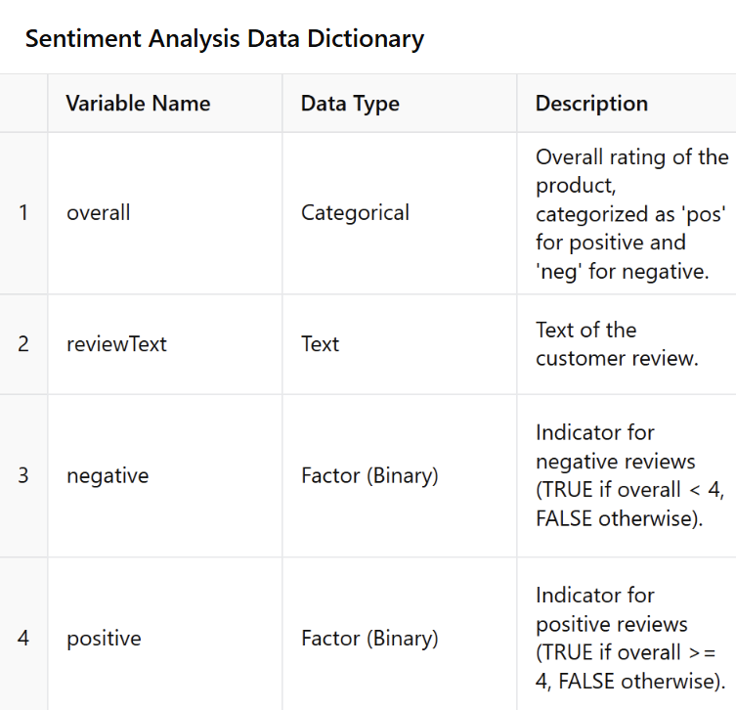
Dataset Description
Added a column that labeled reviews as "positive" (ratings ≥ 4) and "negative" (ratings < 4).
Preprocessed dataset cleaned by removing NA values and irrelevant columns.

Slide 5
Experiment Details
Data & Text Processing
Removed missing values and irrelevant columns.
Labeled sentiments based on ratings.
Data Partition & Balancing
Split dataset into 70% training and 30% testing for model development and validation.
Model Construction
Created a document corpus matrix to transform text into numerical data.
Leveraged machine learning for efficient text classification.
Model Evaluation
Used cross-validation for performance evaluation
Key metrics: accuracy, precision, sensitivity, specificity, demonstrating high reliability.

Slide 6
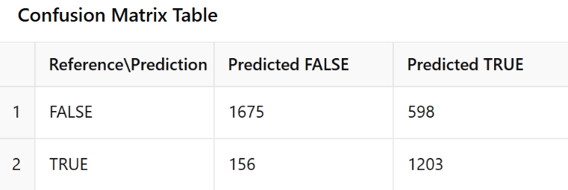
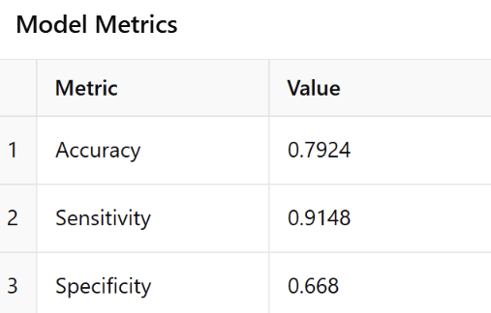
Visualization & Key Insights
Reference level = negative reviews
Strengths: High accuracy in predicting true negatives and true positives, and particularly high performance in predicting true positives reviews
Weaknesses: Moderate specificity suggests room for improvement in identifying positive reviews
The model shows robust classification accuracy
Improvements could focus on reducing false negatives for better sensitivity

Slide 7

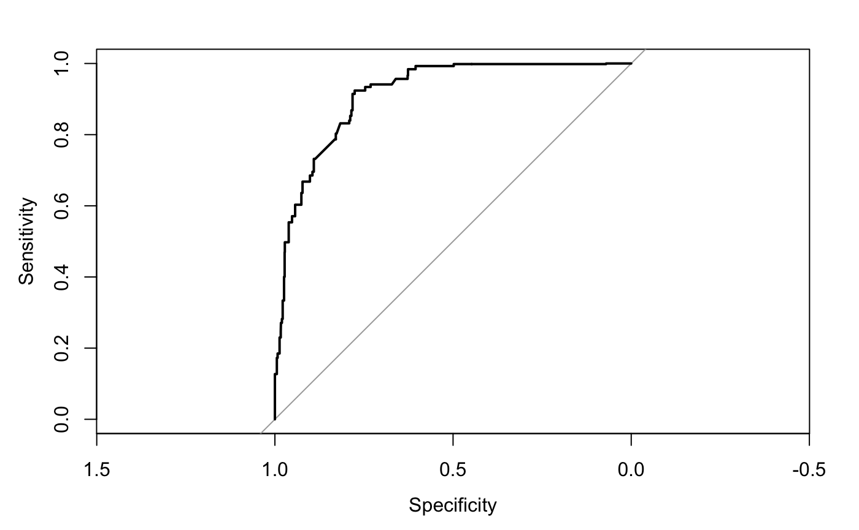
Visualization & Key Insights
The ROC curve shows strong classification performance with high sensitivity and specificity.
The area under the curve (AUC) demonstrates a reliable model with excellent predictive power.
AUC is at 0.9129

Slide 8
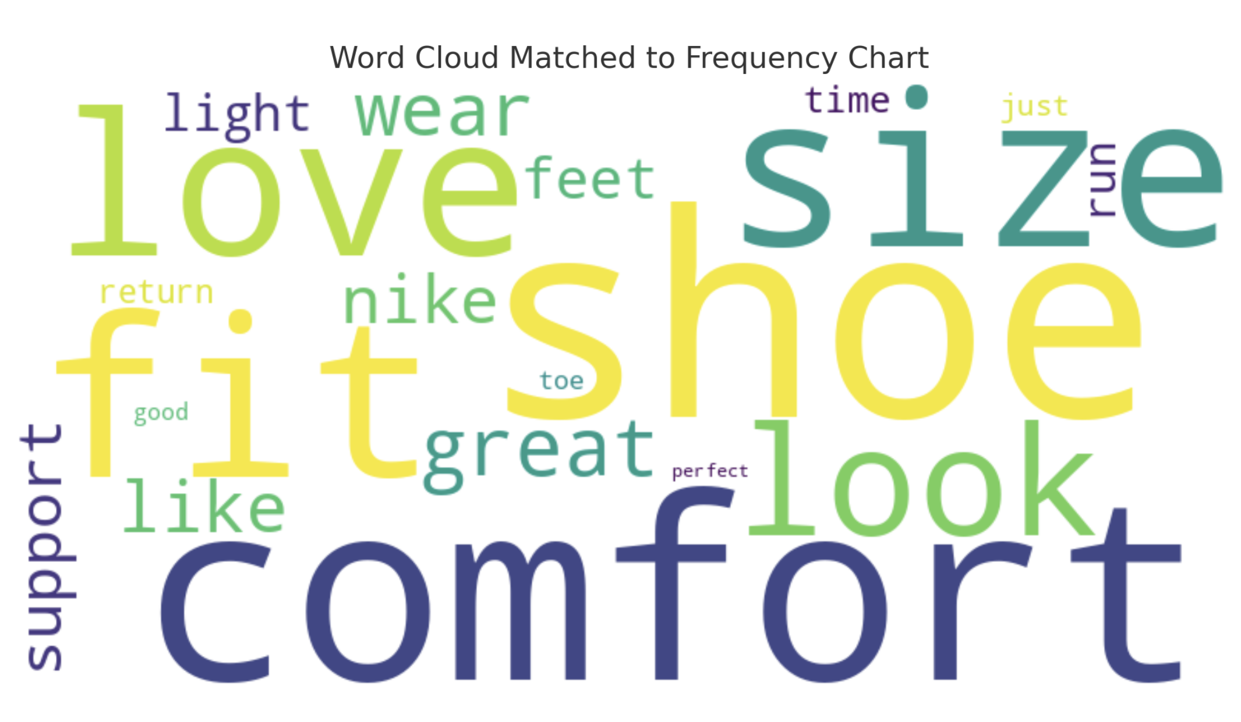
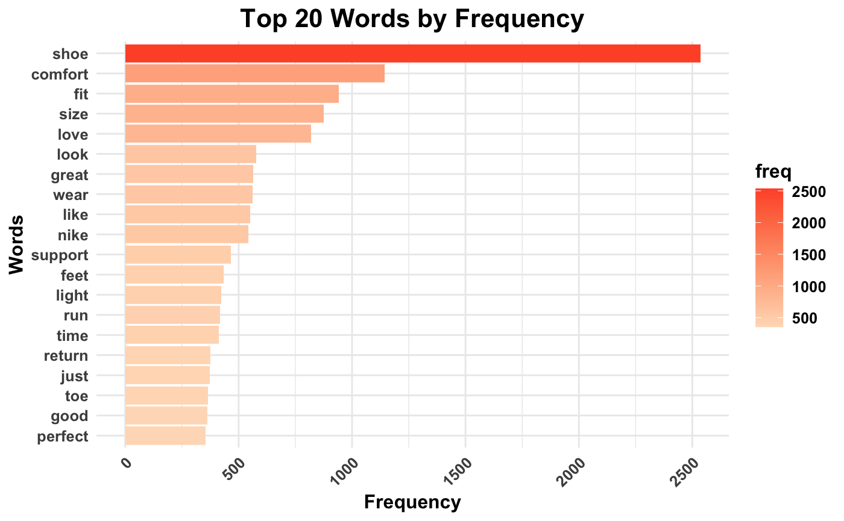
Visualization & Key Insights
The word "shoe" is the most frequent, indicating it’s the most popular product
Top words like "comfort," "fit," "size," and "love" reflect customers' focus on product usability and satisfaction, and suggest that Amazon should prioritize features like comfort and fit in product design
Words like "support" and "return" highlight secondary themes like addressing common concerns like size and return policies can improve customer satisfaction

Slide 9

Recommendations
How can businesses grow with this model?
Focus on frequently occurring terms in positive reviews to pinpoint what customers value the most
Highlight the most praised attributes in marketing campaigns and product descriptions
Address minor areas of improvement to turn good experiences into exceptional ones
Engage with customers who leave positive reviews to foster brand loyalty
Compare your positive reviews to competitors' feedback to see where your product or service stands out

Slide 10

conclusion
Deeper Market Understanding: Sentiment analysis enables businesses to gauge customer perceptions and identify market trends.
Actionable Insights: Positive reviews highlight strengths for marketing and innovation, while negative reviews reveal areas for improvement.
Business Growth: Leveraging sentiment analysis helps companies stay competitive, adapt to customer needs, and drive long-term success.

